Slide 1
Modes
October 17, 2014
Notes:
Guidewire training materials contain Guidewire proprietary information that is subject to confidentiality and non-disclosure agreements. You agree to use the information in this manual solely for the purpose of training to implement Guidewire software solutions. You also agree not to disclose the information in this manual to third parties or copy this manual without prior written consent from Guidewire. Guidewire training may be given only by Guidewire employees or certified Guidewire partners under the appropriate agreement with Guidewire.

Slide 2
Lesson objectives
By the end of this lesson, you should be able to:
Describe how modes are used to create different versions of a single container
Implement modal PCFs
This lesson uses the notes section for additional explanation and information. To view the notes in PowerPoint, choose View→Normal or View→Notes Page. If you choose to print the notes for the lesson, be sure to select “Print hidden slides.”

Slide 3
Lesson outline
Mode fundamentals
Implement modal PCFs

Slide 4
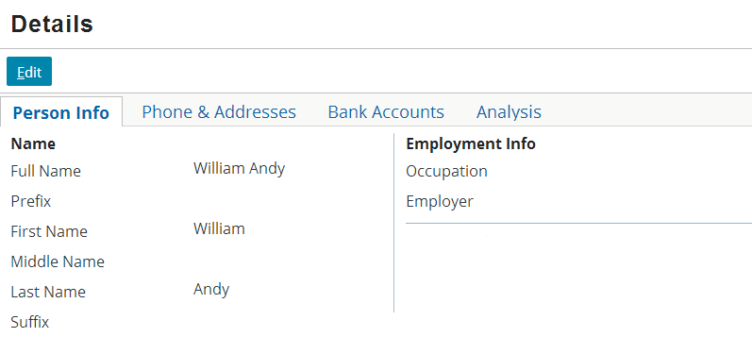
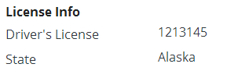
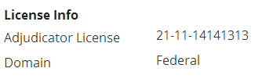
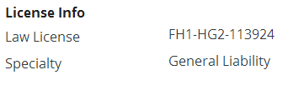

Widgets that need to vary
if contact is a person
if contact is an adjudicator
if contact is an attorney
In some cases, widgets need to vary significantly based on business scenario
if contact is a doctor

Slide 5
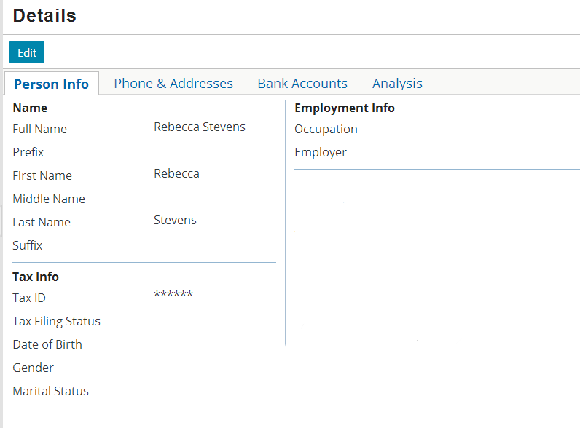
Addressing all scenarios within one PCF
if contact is attorney, adjudicator, or person
if contact is person
if contact is adjudicator
if contact is attorney
if contact is doctor
All fields in one container makes container difficult to maintain
Notes:
For user interfaces that need different structures, you could include all the possible structures in a single PCF file. Including all the possible variants in a single PCF file adds to the complexity of the PCF and eliminates the possibility of reusable containers. In addition, much of the conditional logic becomes overly repetitive. Developers of applications prefer working with smaller components: they are easy to create, debug, modify, and maintain.

Slide 6
Addressing scenarios with multiple PCFs
InputSet for ABPerson
InputSet for ABAdjudicator
Get InputSet for <contact's subtype>
Sometimes, best approach is to use a series of separate PCFs, each for a specific scenario
The application can reference the PCF appropriate to a given scenario
InputSet for ABAttorney
InputSet for ABDoctor
Notes:
When a single PCF cannot easily accommodate a variety of business cases, it is often easier to create a set of PCFs, one for each use case. Each version needs a value to identify the use case it is designed for. When the PCF is called, it is called by both its name and its "use case". Modes exist in the PCF architecture to implement this "use case" versioning.

Slide 7




Modes
Mode is a property used for PCFs that are appropriate for a given business scenario
Mode identifies which scenario(s) the PCF is for
Modal PCFs always come in sets
SubtypeInfoInputSet mode = ABPerson, ABPolicyPerson
SubtypeInfoInputSet mode = ABAttorney
SubtypeInfoInputSet mode = ABAdjudicator
SubtypeInfoInputSet mode = ABDoctor
Notes:
There is no requirement for modal PCFs to come in sets. It is possible to create a single PCF with a mode that had no counterparts. This sort of PCF would behave in exactly the same way as a PCF that didn't use modes, which would mean there was no benefit to having made the PCF modal. Therefore, in practice, modal PCFs always come in sets of PCFs.
A modal PCF can have multiple modes. In the slide example, the first SubtypeInfoInputSet is used for contacts of subtype ABPerson or ABPolicyPerson.

Slide 8
Default mode
Modal PCF sets include one PCF with mode of "default", which is used when something references a mode that doesn't otherwise exist
SubtypeInfoInputSet mode = default
SubtypeInfoInputSet mode = ABPerson, ABPolicyPerson
SubtypeInfoInputSet mode = ABAttorney
SubtypeInfoInputSet mode = ABAdjudicator
SubtypeInfoInputSet mode = ABDoctor
Notes:
In the slide example, the default PCF is blank. If a SubtypeInfoInputSet is referenced but the mode it references cannot be found (such as, for example, a reference to SubtypeInfoInputSet with the mode ABPropertyInspector), then the default PCF is used.
In some situations, the "default" mode is assigned to a PCF that has other non-default modes. For example, since all person contacts are either of type ABPerson or one of its children, it would be possible to have assigned ABPerson, ABPolicyPerson, and default to the first SubtypeInfoInputSet.

Slide 9
Common uses of modal PCFs
Modes can be used with:
Detail view panels
Card view panels
Input sets
List view panels
Info bars
Screens
Menu item sets
...and more (refer to documentation)
Modes are often used to accommodate variations in:
Contact type (individuals, companies, and so on)
Line of business (auto, workers' comp, property, and so on)
Notes:
In PolicyCenter, modes are also used to accommodate variations in policy transaction type (submission, change, renewal, cancelation, and so on).

Slide 10
Lesson outline
Mode basics
Implement modal PCFs

Slide 11
Steps to implement modal PCFs
Create modal PCF set
For each PCF, specify its mode(s)
Ensure there is one PCF with "default" mode
Ensure each PCF has identical required variables (in number, type, and order)
Create reference to modal PCF set
Deploy PCFs

Slide 12
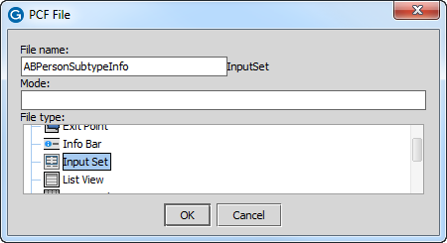
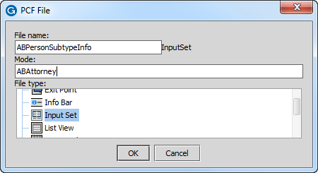
Step 1a: Create modal PCF set
Every PCF must have:
Same ID
Same number, type, and order of required variables
One or more unique modes (runtime error occurs if referenced mode belongs to multiple PCFs in same set)
Notes:
Except for the mode of "default", mode values are not case-sensitive. Guidewire recommends that mode values use the same casing as the values to be passed to the reference tag, however.
If a PCF has more than one mode, then each mode should be listed in the mode property as a pipe-delimited list (such as "ABPerson|ABPolicyPerson").
Every mode must uniquely belong to one and only one PCF in the set. If a mode is listed with two or more PCFs, there will be a runtime error when that mode is referenced because the application will be unable to determine which PCF to use.
After you have created a modal PCF, you cannot modify the mode through the mode property of the PCF. This is because the file name includes the mode or modes, and the two values must remain in sync. If you need to change the mode of a modal PCF (for example, to add an additional mode to it), right-click the PCF in the resources tree and select "Change mode". This allows you change the mode, which is then reflected in both the mode property and the file name.

Slide 13


Modes and subtypes
Mode property recognizes explicitly specified subtypes
Not aware of a subtype's hierarchy
Unspecified subtypes will not render
Use pipe delimiter (|) to specify more than one subtype
ABPersonVendor not specified so will not show
Notes:
In the slide example, the first modal PCF has only a single mode, ABPerson. It will be used in any circumstance where the mode value is "ABPerson", but it will not be used if the mode value is "ABAttorney" or "ABDoctor", even though they are subtypes of ABPerson. The second modal PCF has three modes, ABPerson, ABDoctor, and ABAttorney. This modal PCF will be used for any ABPerson object, whether it is ABPerson or one of its subtypes.
In the base application, there is actually an ABPersonVendor subtype in between the ABPerson level and the ABAttorney or ABDoctor level. Because ABPersonVendor is not specified, the modal PCF will not be displayed.

Slide 14

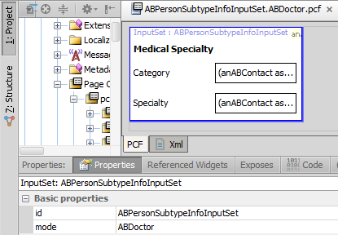
Modal widgets in Studio
In Studio, modal PCFs are listed as "<ID>.<mode>"
Notes:
If a PCF has multiple modes, it is listed as "<ID>.<mode1>|<mode2>...".

Slide 15
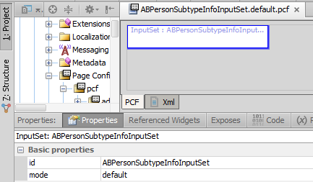

Step 1b: Create default PCF
One PCF should have "default" as (one of) its mode(s)
"default" must be lower case
Runtime error occurs if unknown mode is called and no "default" widget exists
Notes:
Aside from the shared IDs, modes, and required variables, there is no configuration difference between a modal PCF and a non-modal PCF.
In order for the default widget to be used by default, the mode must be "default" in lower case. If it is not specified this way, then Guidewire treats the modal widget set as if it has no default widget . If the application encounters an unknown mode (and cannot find the default PCF because of a case-mismatch), then the user will see an error similar to this:
GWConfigurationException: <CONTAINER>/(InputColumnWidget)/(InputSetRefWidget) is looking for a non-existent widget with id="..." and mode="...".

Slide 16
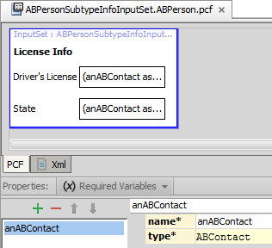
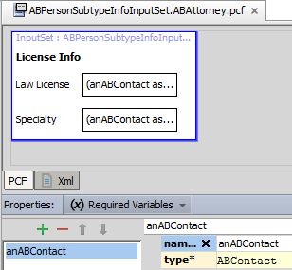
Step 1c: Ensure same required variables
Ensure each modal PCF has identical required variables
Variable definition (type)
Number of variables
Order of variables

Slide 17
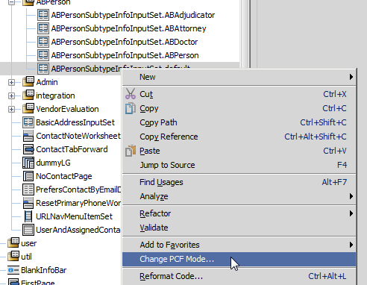
Changing modes
Context menu -- > Change PCF mode…
Changes mode property
Updates file name
Notes:
If you need to change a PCF's mode (for example, to add an additional mode to it), right-click the file name in the resources tree and select "Change PCF mode…".
This is not an issue for PCFs created by customers because those files exist only in the configuration directory. There is no need to keep these file names fixed.

Slide 18
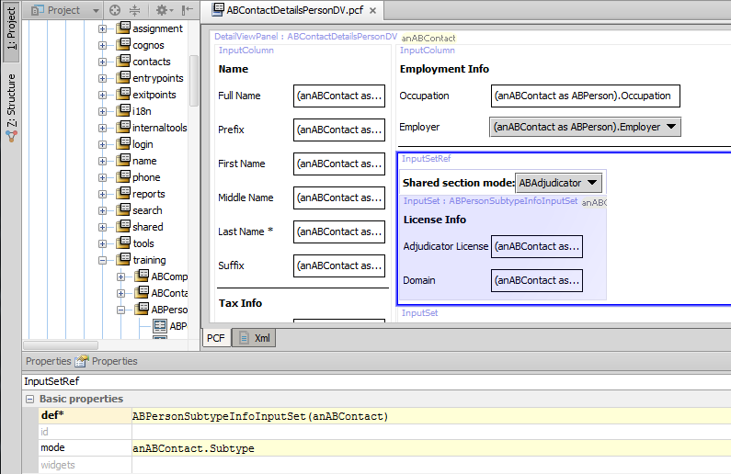

Step 2: Create reference to PCF set
Reference must specify
PCF set to use
Mode within set to use
Notes:
The value to pass for mode is usually a field of one of the base objects available to the parent container.

Slide 19
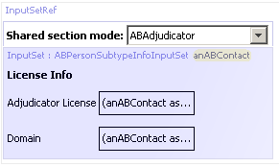
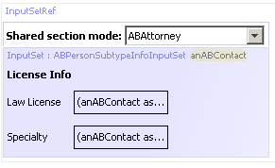
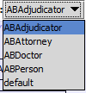
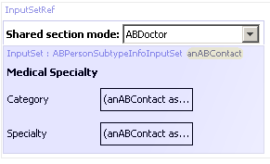
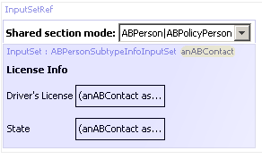

Modal references in Studio
PCF Editor shows modal as dropdown that lists every mode
The PCF Editor displays currently selected mode in the canvas
Notes:
When you open a file with a modal reference, Studio displays the embedded modal PCF for the first mode when listed alphabetically.
Double-clicking the dark-blue area opens the currently selected modal widget.

Slide 20
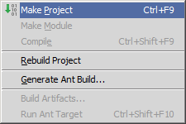
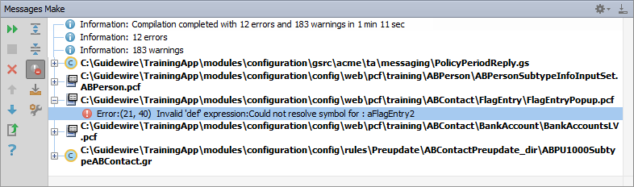
Make project to see all PCF errors
Build → Make Project
Compiles only modified files since the last compilation
Opens Messages (Make) window for build summary
Filter for errors
Great way to see all PCF errors
Notes:
Make Project: All the source files in the entire project that have been modified since the last compilation are compiled. Dependent source files, if appropriate, are also compiled. Additionally, the tasks tied to the compilation or make process on modified sources are performed.

Slide 21
Step 3: Deploy PCFs
Restart Server
Reload PCFs
PCFs read at server startup
ALT+SHIFT+L
Internal debug tools enabled
Internal Tools
Reload → Reload PCF Files
Page Configuration File
Page Configuration File
Notes:
It is also possible to reload PCF files using the Guidewire API and/or internal server tools. The Reload PCF command can be found on the Reload page in Internal Tools. To access Internal Tools, the EnableInternalDebugTools setting in the config.xml file must be set to true. The keystroke to open the Internal Tools page is ALT+SHIFT+T. In the tab bar, select Internal Tools --> Reload. On the Reload page, click the Reload PCF Files button. Both the keystroke ALT+SHIFT+L and the Reload PCF Files button call the same static method: gw.api.tools.InternalToolsUtil.reloadPCFs().

Slide 22
Lesson objectives review
You should now be able to:
Describe how modes are used to create different versions of a single container
Implement modal PCFs

Slide 23
Review questions
Name two business situations in which it might be useful to use modal PCFs.
For a given set of modal PCFs, what two things must all of the PCFs have in common?
Can a PCF have more than one mode?
Can the same mode be used by more than one PCF within the same modal set?
What happens if a reference identifies a mode, but there is no PCF with that mode in the set?
Notes:
Answers
1) Possible answers: Different types of contacts (individual vs. business); different lines of business (auto vs. property).
2)All of the files must have the same required variables (identical in number, order, and type), as well as the same ID.
3) Yes.
4) No. If the same mode is used in multiple PCFs in the same set, then the application cannot determine which file to use and a runtime error occurs.
5) If a PCF with a mode of "default" exists, then that default is used. Otherwise, a runtime error occurs.

Slide 24
Notices
Copyright © 2001-2014 Guidewire Software, Inc. All rights reserved.
Guidewire, Guidewire Software, Guidewire ClaimCenter, Guidewire PolicyCenter, Guidewire BillingCenter, Guidewire Reinsurance Management, Guidewire ContactManager, Guidewire Vendor Data Management, Guidewire Client Data Management, Guidewire Rating Management, Guidewire InsuranceSuite, Guidewire ContactCenter, Guidewire Studio, Guidewire Product Designer, Guidewire Live, Guidewire DataHub, Guidewire InfoCenter, Guidewire Standard Reporting, Guidewire ExampleCenter, Guidewire Account Manager Portal, Guidewire Claim Portal, Guidewire Policyholder Portal, ClaimCenter, BillingCenter, PolicyCenter, InsuranceSuite, Gosu, Deliver Insurance Your Way, and the Guidewire logo are trademarks, service marks, or registered trademarks of Guidewire Software, Inc. in the United States and/or other countries.
All other trademarks are the property of their respective owners.
This material is confidential and proprietary to Guidewire and subject to the confidentiality terms in the applicable license agreement and/or separate nondisclosure agreement.
This file and the contents herein are the property of Guidewire Software, Inc. Use of this course material is restricted to students officially registered in this specific Guidewire-instructed course, or for other use expressly authorized by Guidewire. Replication or distribution of this course material in electronic, paper, or other format is prohibited without express permission from Guidewire.
Guidewire products are protected by one or more United States patents.

